Slide 1
Periodic Noise Reduction Using Frequency Domain Filtering

Slide 2
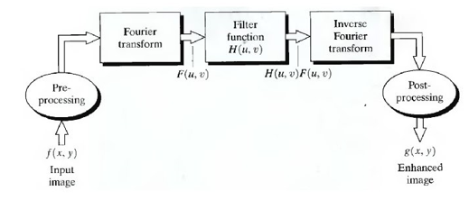
Periodic Noise Reduction by Frequency Domain Filtering
Periodic noise is due to the electrical or electromechanical interference during image acquisition.
Can be estimated through the inspection of the Fourier spectrum of the image.

Slide 3
Noise Reduction using Frequency Domain Filtering
BandReject filters
BandPass filters
Notch filters

Slide 4
Bandreject filters
  Remove or attenuate a band of frequencies.
    D₀ is the radius.
    D(u, v) is the distance from the origin, and
    W is the width of the frequency band.

Slide 5
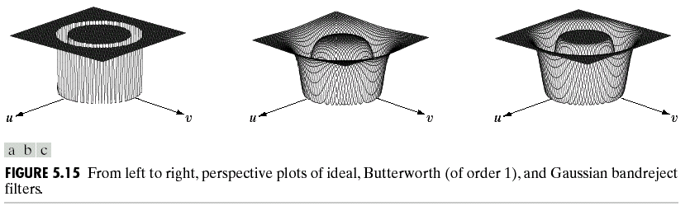
Butterworth and Gaussian Bandreject Filters
Butterworth bandreject filter (order n)
Gaussian band reject filter

Slide 6
Bandpass filter
Obtained form bandreject filter
H_{bp}(u,v)=1-H_{br}(u,v)
The goal of the bandpass filter is to isolate the noise pattern from the original image, which can help simplify the analysis of noise, reasonably independent of image content.

Slide 7
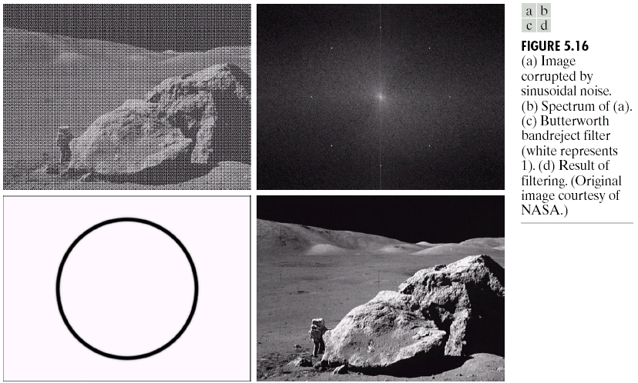
Periodic Noise Reduction by Frequency Domain Filtering

Slide 8
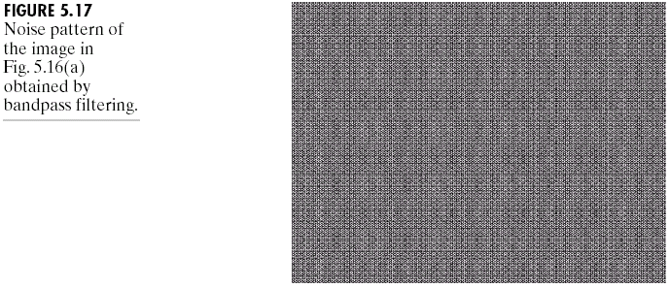
Result of The BandPass Filter

Slide 9
Notch filters
Notch filter rejects (passes) frequencies in predefined neighborhoods about a center frequency.
  where

Slide 10
Notch Filters
Butterworth notch filter
Gaussian notch filter
Note that these notch filters will become highpass when u₀=v₀=0

Slide 11
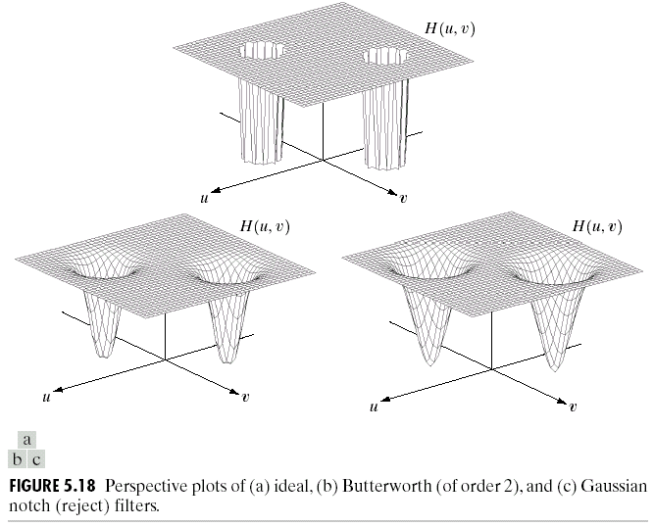
Notch filters

Slide 12
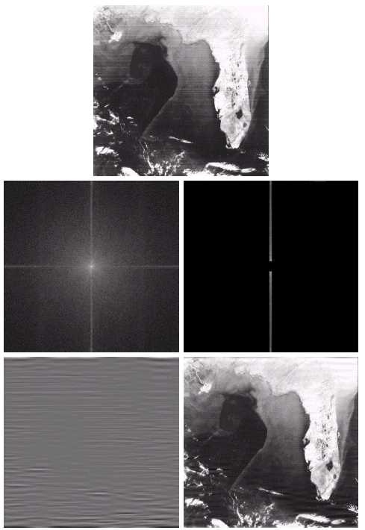
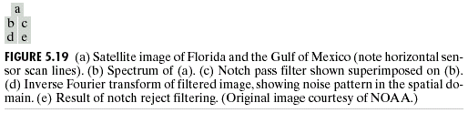
Use 1-D Notch pass filter to find the horizontal ripple noise

